Slide 1
Project 2: Multi-Tier Architecture in AWS
Everett Enterprises
Presented by Team Trinity(TT) Soakers:
J. Tucker, J.Jay, T. Ndukong, T. Hill
CCP Tyrone Hill

Slide 2
AWS Technical Architecture (Diagram)
A complete overview of the design
CCP Tyrone Hill

Slide 3
















AWS Cloud
US-East-1
VPC (10.0.0.0/16 –> 65,536 add.)
AZ us-east-1a
Public Subnet
10.0.2.0/24 -> 249 add.
Private App Subnet
Database Subnet
10.0.4.0/24 -> 250 add.
NAT gateway
Website Servers
EFS Mount Target
Aurora Read Replica
10.0.0.0/24 -> 249 add.
Users
Application Load Balancer
Auto Scaling Group
Amazon EFS
Internet gateway
Public Subnet
Database Subnet
NAT gateway
EFS Mount Target
Website Servers
Aurora Primary DB
Internet
10.0.1.0/24 -> 248 add.
10.0.3.0/24 -> 250 add.
Private App Subnet
10.0.5.0/24 -> 250 add.
AZ us-east-1b

Slide 4
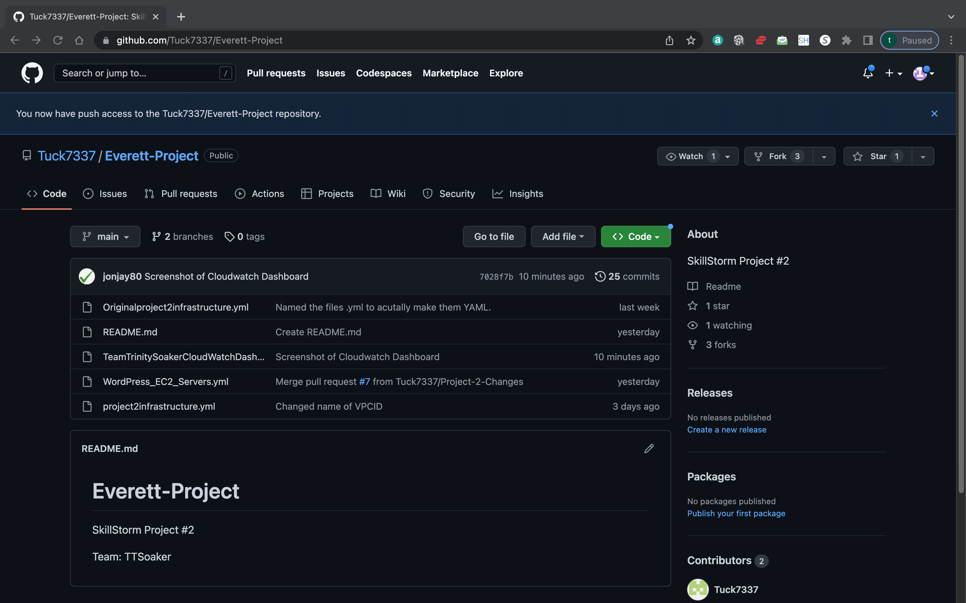


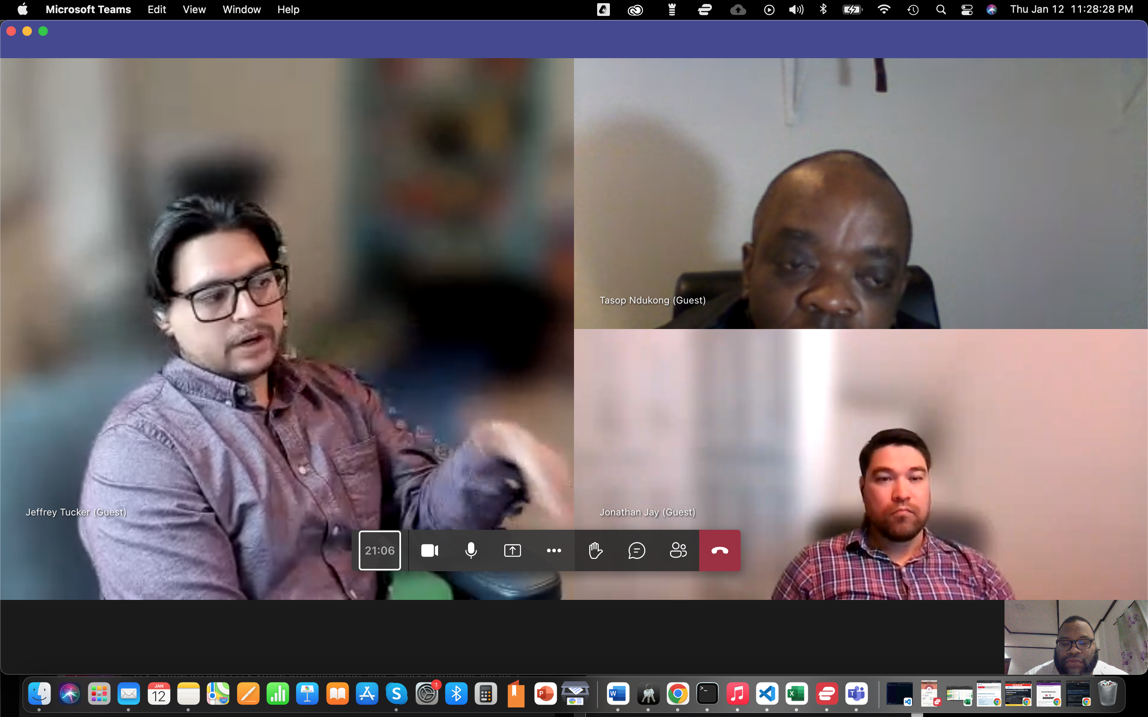

Development
CCP Jeffrey Tucker

